Slide 1


// HACKATHON 2026 SUBMISSION
AEGIS-AI
Detect Cyber Threats Before They Reach You
Drop a screenshot, PDF, or link. AEGIS-AI reads it with OCR, reasons about it with an enterprise LLM, and hands back a plain-English verdict in seconds.
< 3s
5
100%
IBM
Average scan time
Risk levels detected
Private — no data stored
Bob-powered intelligence

Slide 2




// the problem
Threats look exactly like everything else you trust
Modern phishing, smishing, and fraud attempts are engineered to be indistinguishable from real messages — and most people have no tool to check before they click.
Attacks evolve daily
No safety net for non-experts
Verification takes too long
New phishing kits, QR scams, and BEC scripts appear faster than awareness training can keep up.
Security tools are built for analysts — not for someone staring at a suspicious text on their phone.
By the time a link is manually checked, the damage — a click, a login, a payment — is often already done.
The result: a defensive gap that grows every year technology gets more convincing.
AEGIS-AI
02 / 13

Slide 3

// the solution
One drop-zone. One verdict. Zero jargon.
File, screenshot, PDF, or URL — any format goes in
1
OCR extracts every word, even from images
2
AEGIS-AI bridges the gap between sophisticated cyber threats and everyday users who lack the tools to identify them. Upload anything suspicious — a screenshot, a PDF, a link — and get an instant, explainable risk verdict.
IBM Bob's enterprise LLM reasons about intent
3
"Cyber threats don't discriminate by technical knowledge. AEGIS-AI gives everyone the same defensive edge."
A plain-English verdict comes back in under 3 seconds
4
AEGIS-AI
03 / 13

Slide 4




// pipeline overview
From pixel to threat intelligence
Every scan follows the same four-step pipeline — fast, explainable, and fully automated.
01
02
03
04
File Upload
OCR Text Extraction
IBM Bob LLM Analysis
Risk Scoring
Drop a screenshot, PDF, or photo. Validated client-side and sent securely over HTTPS.
Tesseract + PIL pull every word of text out of the image, pixel by pixel.
Bob reasons about intent, tone, and urgency — semantic understanding, not keyword matching.
Result maps to one of five color-coded risk tiers with a plain-English explanation.
POST /api/scan
file: screenshot.png
extracted_text →
"click here to verify..."
classify(text) →
threat_type + confidence
risk_level: "Low" (25/100)
AEGIS-AI
04 / 13

Slide 5
// risk intelligence
Five-tier risk intelligence
Every result maps to a clearly defined risk level with color-coded guidance — no ambiguous scores.
5
25
50
75
95
Safe
Low
Medium
High
Critical
No threat indicators found
Minor caution advised
Verify before acting
Strong threat signals
Do not interact — report it
Safe
Critical
AEGIS-AI
05 / 13

Slide 6
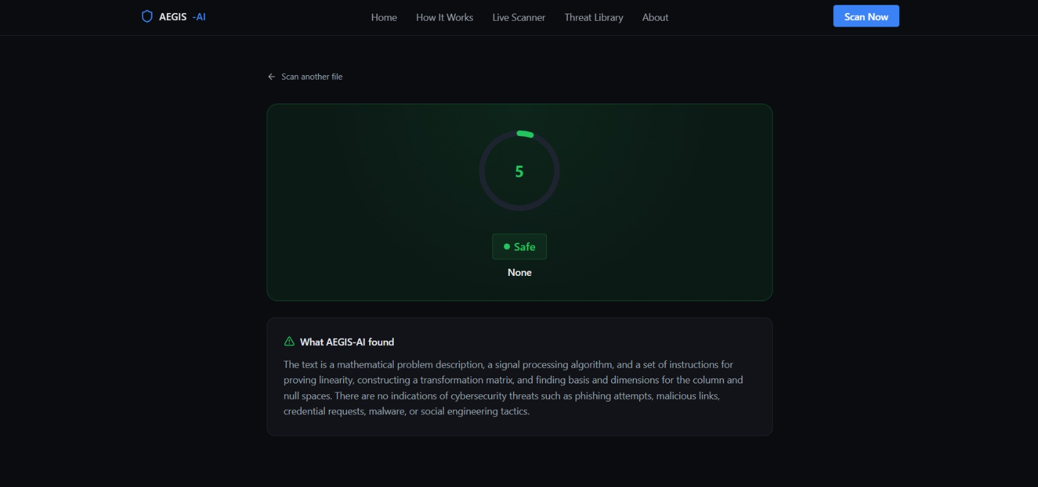
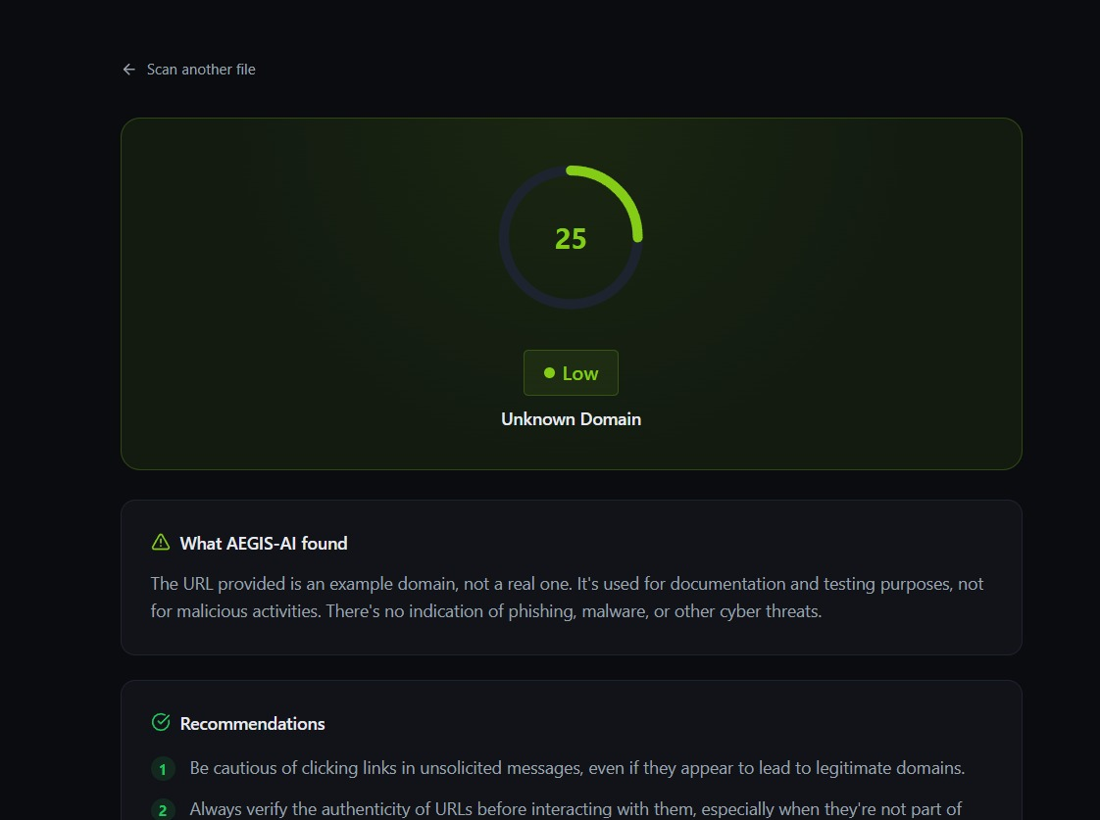
// live scanner — real output
Not a mockup — a working scanner
Two real AEGIS-AI results, captured live from the deployed app.
Verdict: Safe (5/100)
AEGIS-AI correctly identified an academic/technical document as benign — no false alarm.
Verdict: Low Risk (25/100)
URL scan flags an example/testing domain as low risk with clear next-step recommendations.
AEGIS-AI
06 / 13

Slide 7





// threat library
Trained to recognize the full attack surface
Phishing
Social Engineering
● High
Business Email Compromise
Fraud
● High
Smishing (SMS Phishing)
Social Engineering
● High
QR Code Phishing (Quishing)
Social Engineering
● Medium
Safe / Benign Content
No Threat
● Safe
AEGIS-AI
07 / 13

Slide 8




// why AEGIS-AI
Built on four non-negotiable principles
Privacy by Default
IBM Bob-Powered
Files are processed in-memory and immediately discarded. Nothing is stored, logged, or shared.
Backed by IBM's enterprise language model — not a toy keyword classifier.
Explainable Results
Built for Everyone
Every verdict includes a plain-language explanation. No black-box outputs.
No security knowledge required. Results are plain English with clear next steps.
AEGIS-AI
08 / 13

Slide 9
// under the hood
The stack powering every scan
LLM ENGINE
Enterprise language model for threat classification
IBM Bob
OCR
Pixel-to-text extraction from any image format
Tesseract / PIL
BACKEND
Lightweight REST API, no data persistence
Python / Flask
FRONTEND
Fast, accessibility-first UI
React + Vite
ANIMATIONS
Smooth, motion-safe scroll animations
Framer Motion
AEGIS-AI
09 / 13

Slide 10
// integration
How AEGIS-AI talks to IBM Bob
IBM Bob is IBM's enterprise AI platform, routing tasks across frontier and Granite models behind one governed interface. AEGIS-AI calls into it as the reasoning engine for every scan.
01
02
03
04
Secure Request
Enterprise Reasoning
Structured Classification
Risk Mapping
Once OCR pulls the text out, AEGIS-AI's backend sends it to IBM Bob over an authenticated HTTPS call.
Bob's LLM engine reads the text and reasons about intent, tone, and urgency — the same governed model backbone IBM runs for enterprise workloads.
Bob returns a threat type and confidence score as machine-readable JSON, not a raw guess.
AEGIS-AI translates Bob's classification into a five-tier score with a plain-English verdict.
POST /bob/analyze
text: extracted_text
bob.reason(text) →
intent + urgency signal
response →
threat_type + confidence
risk_level: "Low" (25/100)
AEGIS-AI
10 / 13

Slide 11

// differentiation
What sets AEGIS-AI apart
Privacy-First by Design
Zero Setup, Zero Cost
Most scanners log and retain every upload. AEGIS-AI processes in-memory and discards it immediately — nothing is stored.
No account, install, or subscription like enterprise security suites. Drop a file and get a verdict.
Explainable, Not a Black Box
Built for Everyone, Not Analysts
Most tools return a raw score or log entry. Every AEGIS-AI verdict comes with a plain-language reason.
Most cyber tools are built for SOC teams. AEGIS-AI needs zero security background — just plain English.
AEGIS-AI
11 / 13

Slide 12
// mission
Cybersecurity awareness,
powered by AI
AEGIS-AI bridges the gap between sophisticated cyber threats and everyday users who lack the tools to identify them — giving everyone the same defensive edge, regardless of technical background.
3s
5
0
From upload to verdict
Threat categories covered
Files retained after scanning
AEGIS-AI
12 / 13

Slide 13
Try AEGIS-AI
Free. Instant. Private. No account required.
Scan a File Free →
Disclaimer: AEGIS-AI is an educational and awareness tool. Results are AI-generated guidance, not definitive legal or forensic analysis.
Thank you — questions welcome.

